Slide 1
Detecting Hate Speech
Capstone project by Derek Powell
Notes:
Problem identification:
Abusive communication in communication platforms can hurt user engagement and damage product branding-- both of which can have a high cost. This is especially true for those platforms geared towards child and adolescent markets. In order to properly manage against these potential costs, companies have to be able to identify when and where the abusive communication occurs.

Slide 2

Cyber-bully, intimidation, abusive language…it goes by many names, and it can cost companies money when it pervades their digital communications platforms.
Notes:
Problem identification:
Abusive communication in communication platforms can hurt user engagement and damage product branding-- both of which can have a high cost. This is especially true for those platforms geared towards child and adolescent markets. In order to properly manage against these potential costs, companies have to be able to identify when and where the abusive communication occurs.

Slide 3
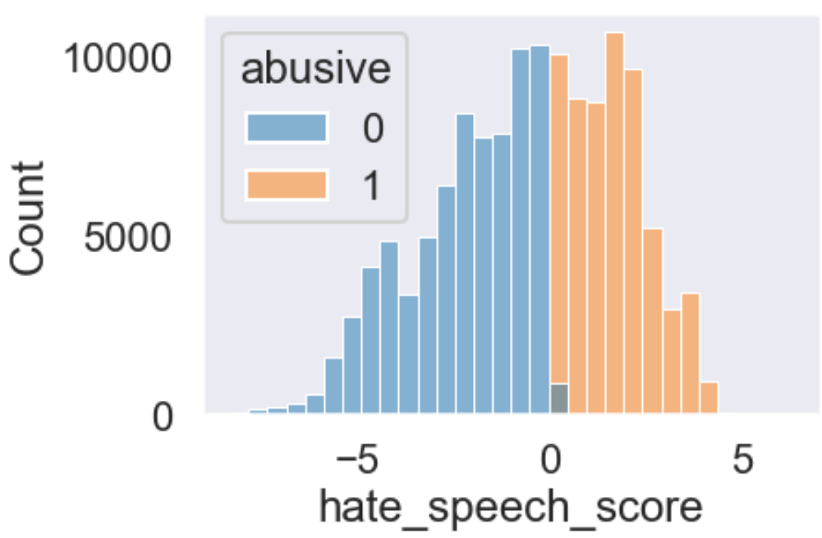
Over 40% of Twitter posts are considered ‘abusive’ in some way, as labeled by a volunteer team of annotators in an independent study.
Notes:
Data Wrangling:
Used a public dataset annotated by a group of students for their phd thesis
130,000 Twitter tweets, scored for several different kinds of abuse, culminating in a continuous variable between -8 and 6, where 6 was 'very abusive in all ways'.
Goal of 90% Recall or higher
Or that 10% or less abusive posts would be misclassified
Took continuous -8 - 6 Abuse score and made it binary, 1 for Abusive, 0 for no
Dropped remaining features
EDA:
Not much EDA, I took a histogram of HateSpeechScore and found a relatively normal distribution of scores given
Visualizing the count of Abusive to non, it was about 45/55, in favor of non-abusive
I confirmed there were no missing values in the corpus text
Pre-Processing:
Removed special characters
Lower case everything
Apply TF-IDF vectorizer
Remove Stop words
Cast back into an array and then into data frame
PROBLEM: Casting the sparse matrix back into an array was crashing my kernel, so I had to decrease corpus size by sampling only 25% of my data.
Later feedback from a mentor said I could have left these as sparse matrices and used them in my model training directly

Slide 4
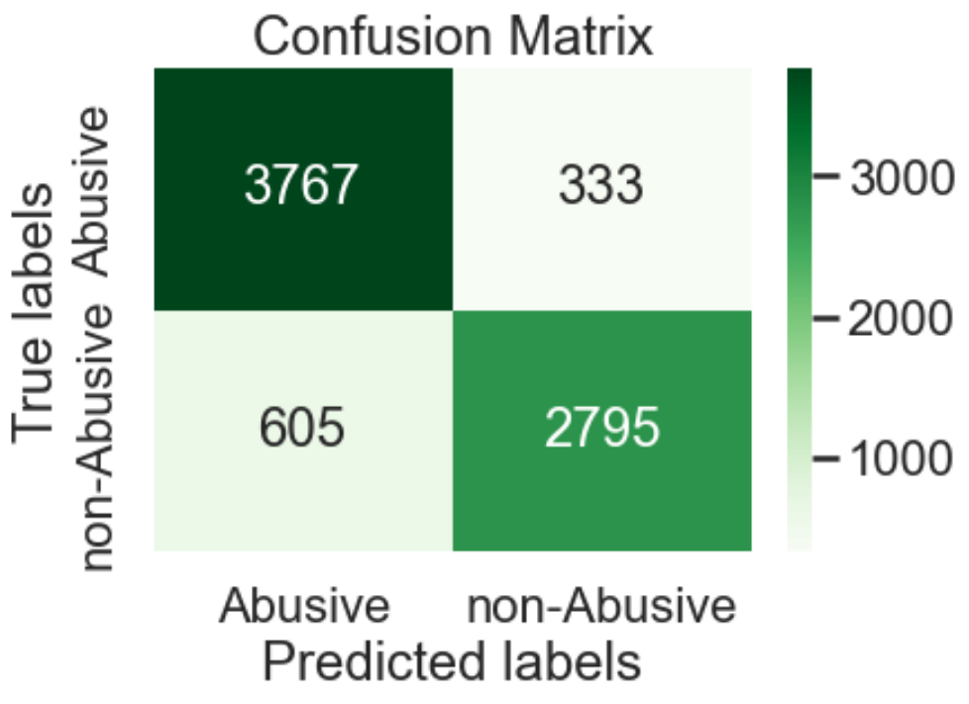
By leveraging machine learning, we can build a model that can evaluate text input and classify abusive text correctly 92% of the time
Notes:
Modeling:
Starting with a logistic regressor model, fairly out of the box hyper params, gave an 88% Recall
Used Grid search to test a multivariate hyper parameter grid, but could not get any appreciable increase with other variables combinations (<1/100% increase).
Then trained a RandomForest model, again using gridsearch to optimize hyperparams and ended up with a model that had Recall 92%

Slide 5

By limiting cyber bulling and other forms of abusive communication, companies can nurture and grow user engagement.
Notes:
Additional work that could be done to possibly improve further upon the results:
Try additional models (e.g. Ridge Regressor), or to
use the original space matrices (post-vectorization) in the model training instead of casting them into data frames.
Additional text could be brought in from other non-Twitter sources to diversity the nature of communication to more closely align to a different platform (e.g. gaming industry).

Slide 6
Future Scope
Using the full dataset via sparse matrices in training
Using a different dataset from a different platform, e.g., a gaming platform, to get a different flavor of digital communication
Using n-grams of 2 or 3 to gather additional context of the text
Using alternate models, such as SVM or deep learning
Using ‘Recall’ as evaluation metric in GridSearch instead of ‘Accuracy’

